Slide 1

The Journey: From Unsure to Insured
A gamified chatbox for educating young women about the importance of vehicle insurance
The Edge

Slide 2

Candice
20-something year old recent graduate looking to buy her first car

Slide 3
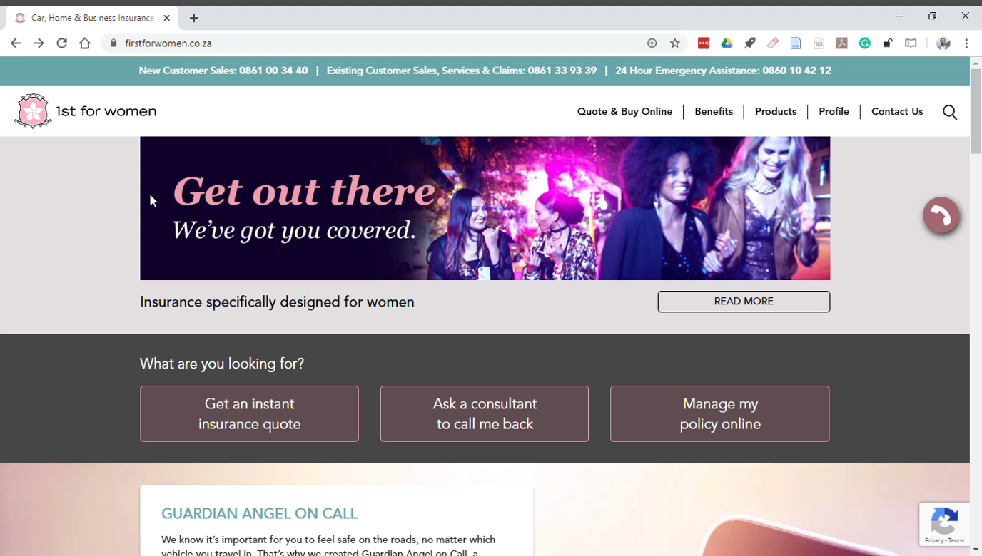

Slide 4


